Slide 1

Project BFSS
Deep Dive on Prevalence of Smoking and Heart Diseases in the US
Identifying focal reasons for heart related issues with big data analysis
By
Alisha Minj
WG56858

Slide 2
Exploring the Big Data Problem in Healthcare
Project BRFSS
Lack of data infrastructure to capture and store large amounts of data
Inadequate analytics capabilities to analyze and interpret data.
Inability to effectively aggregate data from multiple sources.
Ensure data security and Comply with regulations

Slide 3
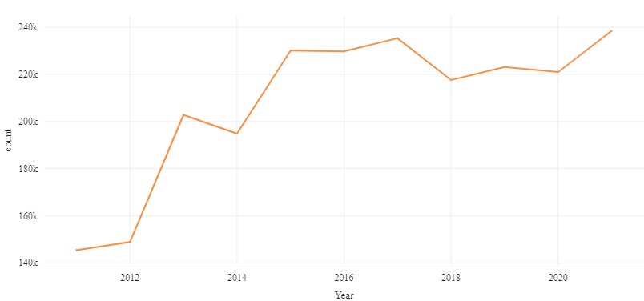
Behavioral Risk Factor Surveillance System
Project BRFSS
https://github.com/alishaminj12/Final_Project

Slide 4

Project BRFSS
Interpret
To identify habits of patients prone to Smoking
Identify prevalence of heart disease

Slide 5
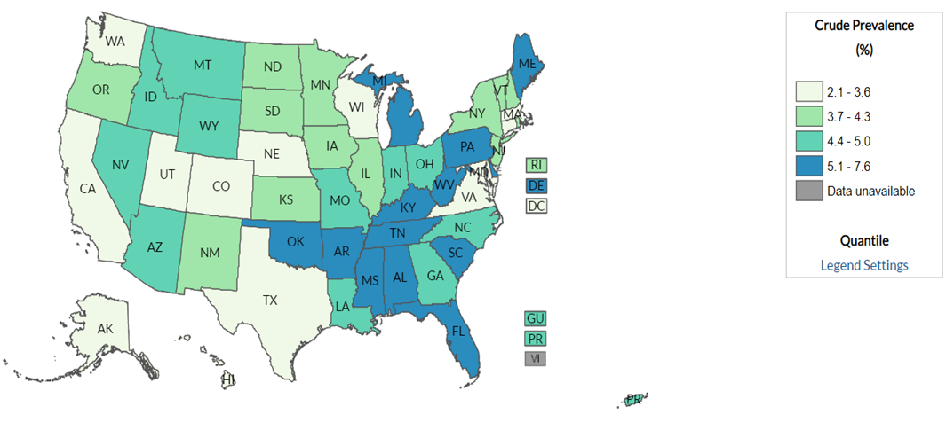
Ever told you had a heart attack (myocardial infarction) ?
Project BRFSS

Slide 6
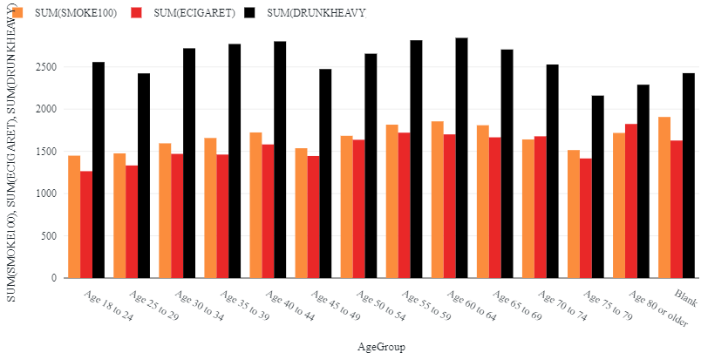
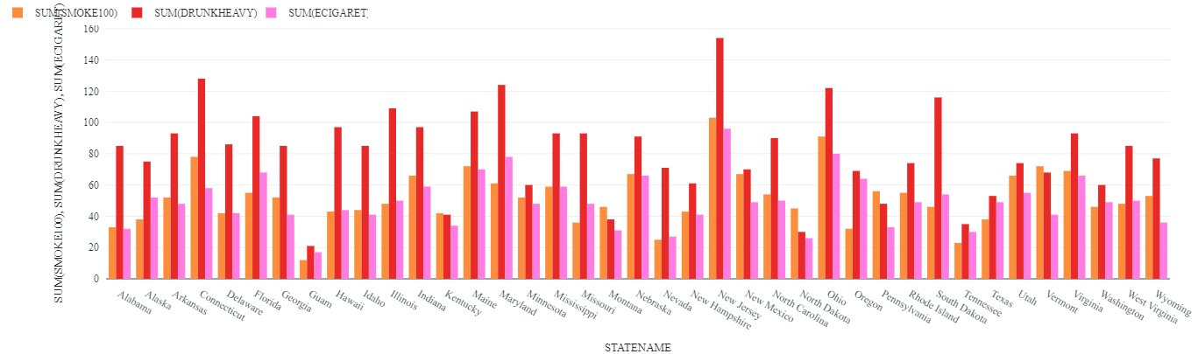
Project BRFSS
Analysis
Smoking Patterns
Most of the respondents prefer drinking
In New Jersey, has maximum Alcohol intake, smoking and E- cigarettes are also popular
Acceptance of E- cigarettes

Slide 7
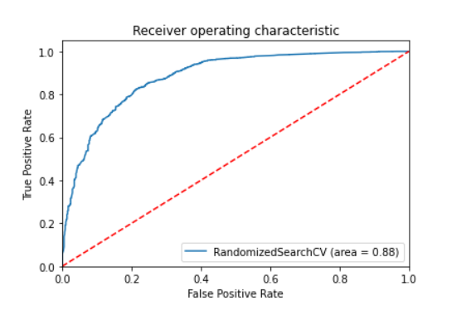
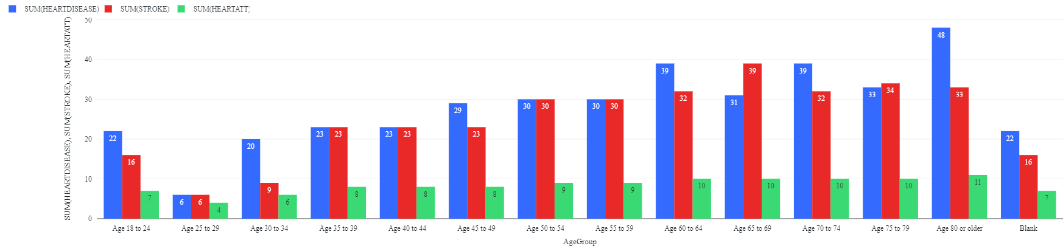
Heart Attack Prediction
Project BRFSS
Analysis
Ohio, Maine, Washington, Virginia are having more prone heart attacks
Performed logistic Regression

Slide 8
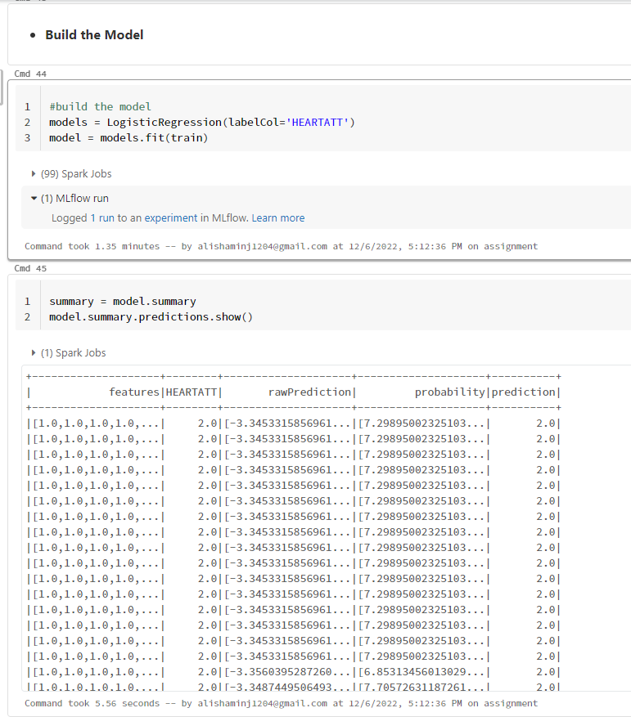
Working on markdown in PySpark
Databricks
Project XYZ

Slide 9
Recommendation
Include specific question and take of the data inconsistencies.
Develop a strategy for data storage and management.
Employ data security and privacy measures to ensure the safety of patient data
Project BRFSS

Slide 10
THANK YOU!

